Slide 1
.NET Core Workshop
Mariano Sánchez
sanchezmariano@outlook.com @marianosz
http://weblogs.asp.net/marianos

Slide 2
.NET Fragmentation
.NET FRAMEWORK
.NET CORE
XAMARIN
APP
MODELS
WPF
Windows Forms
UWP
iOS
Android
ASP.NET
ASP.NET Core
OS X
BASE
LIBRARIES
Base Class Library
Core Library
Mono Class Library
COMMON INFRASTRUCTURE
Compilers
Languages
Runtime components
Notes:
Notes: Even if we are reusing a lot across components (especially with the open sourcing last year), the reality is that each platform has its own implementation of the base libraries.
Note: .NET Framework BCL and Mono BCL are the same APIs, different implementation. .NET Core “Core Library” is a similar set of APIs, but different.

Slide 3
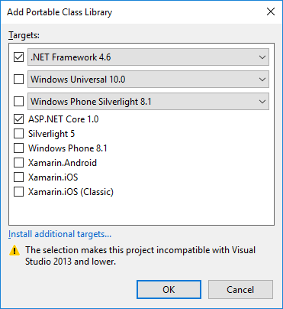

Code Sharing – Portable Class Library
.NET Framework
Windows Universal
Windows Phone

Slide 4
.NET yesterday—app models and libraries
.NET FRAMEWORK
.NET CORE
XAMARIN
APP
MODELS
WPF
Windows Forms
UWP
iOS
Android
ASP.NET
ASP.NET Core
OS X
BASE
LIBRARIES
Base Class Library
Core Library
Mono Class Library
COMMON INFRASTRUCTURE
Compilers
Languages
Runtime components
Notes:
Notes: Even if we are reusing a lot across components (especially with the open sourcing last year), the reality is that each platform has its own implementation of the base libraries.
Note: .NET Framework BCL and Mono BCL are the same APIs, different implementation. .NET Core “Core Library” is a similar set of APIs, but different.

Slide 5
.NET yesterday—reusing code
CHALLENGES
Difficult to reuse skills
Need to master 3+1 base class libraries
Difficult to reuse code
Need to target a small common denominator
Difficult to innovate
Need implementations on each platform
Implementation 3
Implementation 2
Implementation 1

Slide 6
.NET today
.NET FRAMEWORK
.NET CORE
XAMARIN
WPF
Windows Forms
UWP
iOS
Android
ASP.NET
ASP.NET Core
OS X
.NET STANDARD LIBRARY
One library to rule them all
COMMON INFRASTRUCTURE
Compilers
Languages
Runtime components
Notes:
Notes: Please welcome the .NET Standard Library [explain details]
As we move into the future we want to make it much easier for .NET developers to write their code once and be able to execute across .NET implementations, whether that’s .NET Framework, .NET Core, or Mono/Xamarin. To this end, we will continue to evolve and expand the .NET Standard into a set of APIs that are shared broadly across frameworks and application models. This will provide our ecosystem with much more explosive growth with libraries that can shared much more easily.

Slide 7
.NET today—reusing code
BENEFITS
Reuse skills
Master one library, not a platform
Reuse code
Big surface area - no small common denominator
Faster innovation
.NET Standard can grow without updating platforms
Reference implementations
Full implementations
Notes:
Notes: Reusing code is dramatically better with the .NET Standard Library. It includes reference implementations, just like the PCL but it also can be extended with full implementations shared across all platforms.

Slide 8
.NET Standard
.NET Standard is a specification that represents a set of APIs that all .NET platforms have to implement.
This unifies the .NET platforms and prevents future fragmentation.

Slide 9
How is .NET Standard different from .NET Core?
.NET Standard is a specification that covers which APIs a .NET platform has to implement.
.NET Core is a concrete .NET platform and implements the .NET Standard.

Slide 10


.NET Standard
WINDOWS
DESKTOP
CLOUD MICROSERVICES
WINDOWS UWP
IOS, ANDROID
GAMES/ 3D
Visual Studio
.NET STANDARD
Visual Studio for Mac
INFRASTRUCTURE
COMPILERS
LANGUAGES
RUNTIME COMPONENTS
Visual Studio Code
.NET Standard allows sharing code, binaries, and skills between .NET client, server, and all flavors
.NET Standard provides a specification for any platform to implement
All .NET runtimes provided by Microsoft implement the standard

Slide 11
Nothing changes
MY
.NET FRAMEWORK
APP
MY
.NET CORE
APP
MY
XAMARIN
APP
MY STANDARD LIBRARY
EXISTING
.NET STANDARD LIBRARY
EXISTING
PORTABLE CLASS LIBRARY
EXISTING
.NET FRAMEWORK LIBRARY

Slide 12
.NET Standard library
One library to rule them all
Learn one API across ALL .NET platforms
Reuse your code across ALL .NET platforms
Easily consume third-party/OSS libraries across ALL .NET platforms
.NET Standard 1.x
Evolution of Portable Class Libraries (PCLs) with a much simpler model
Two constraints:
API surface relatively small, because .NET Core was small
Can’t reference the vast number of libraries already available for .NET Framework

Slide 13
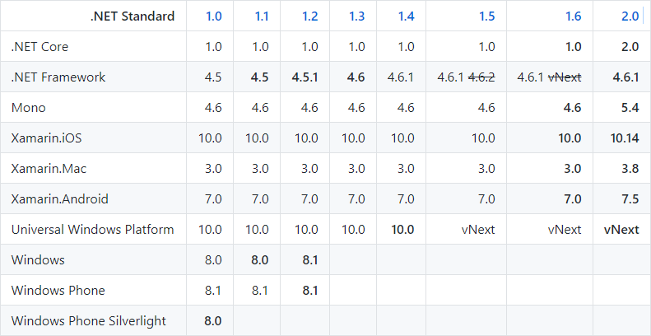
.NET Standard Versions
https://github.com/dotnet/standard/blob/master/docs/versions.md#net-standard-versions

Slide 14
How does .NET Standard work?
.NET Standard is represented by:
The NuGet package NetStandard.Library which contains the reference assembly netstandard.dll
At build time
.NET Standard bridges references to existing .NET Framework and PCL assemblies via type forwarding
At runtime
Each platform provides an implementation for netstandard.dll that type forwards to its implementation

Slide 15
How is .NET Standard different from .NET Core?
.NET Standard is a specification that covers which APIs a .NET platform has to implement.
.NET Core is a concrete .NET platform and implements the .NET Standard.

Slide 16
.NET Standard 2.0
Has much bigger API surface
Extended to cover intersection between .NET Framework and Xamarin
Also makes .NET Core 2.0 bigger as it implements .NET Standard 2.0
+20K
More APIs than
.NET Standard 1.x
Can reference .NET Framework libraries
Compatibility shim allows referencing existing .NET Framework binaries
No recompile required – also covers existing NuGet packages
Limited to libraries that only use APIs that are available for .NET Standard
~70%
of NuGet packages
are API compatible

Slide 17
.NET today
.NET FRAMEWORK
.NET CORE
XAMARIN
WPF
Windows Forms
UWP
iOS
Android
ASP.NET
ASP.NET Core
OS X
.NET STANDARD LIBRARY
One library to rule them all
COMMON INFRASTRUCTURE
Compilers
Languages
Runtime components
Notes:
Notes: Please welcome the .NET Standard Library [explain details]
As we move into the future we want to make it much easier for .NET developers to write their code once and be able to execute across .NET implementations, whether that’s .NET Framework, .NET Core, or Mono/Xamarin. To this end, we will continue to evolve and expand the .NET Standard into a set of APIs that are shared broadly across frameworks and application models. This will provide our ecosystem with much more explosive growth with libraries that can shared much more easily.

Slide 18
APIs in .NET Standard 2.0
XML
XLinq • XML Document • XPath • Schema • XSL
SERIALIZATION
BinaryFormatter • Data Contract • XML
NETWORKING
Sockets • HTTP • Mail • WebSockets
IO
Files • Compression • MMF
THREADING
Threads • Thread Pool • Tasks
CORE
Primitives • Collections • Reflection • Interop • Linq

Slide 19
Demo: .NET Standard

Slide 20
.NET Growth in Visual Studio
+1 million new monthly active .NET developers in last year!

Slide 21
Open source momentum
Community PRs by month
19,000+ Community Contributions from 3700+ Companies outside Microsoft

Slide 22
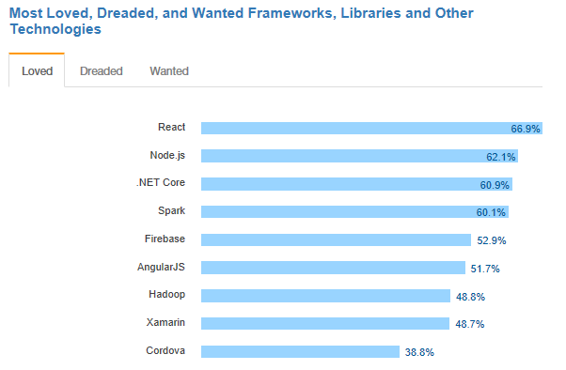
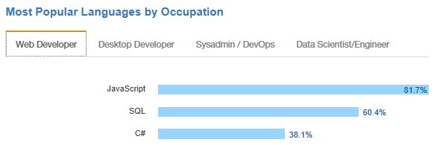
.NET is active and growing
.NET Core debuts at #3 most loved Framework on Stack Overflow Technology Survey 2017
C# is #3 most popular language for desktop and web developers on Stack Overflow Technology Survey 2017
Source: http://stackoverflow.com/insights/survey/2017

Slide 23

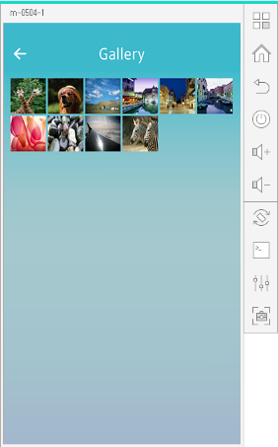
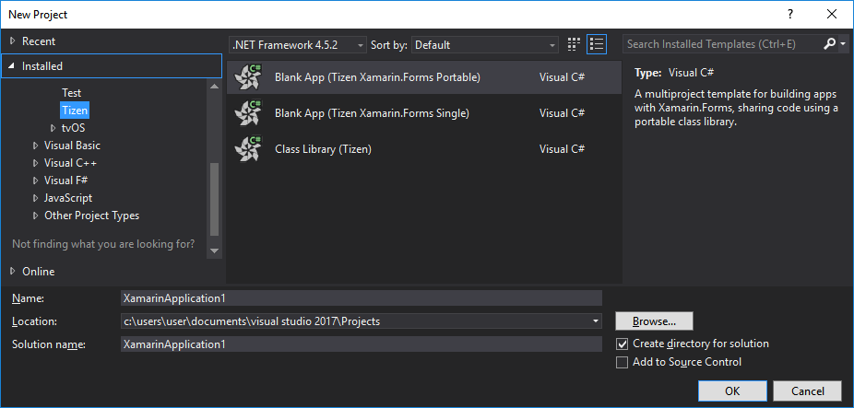
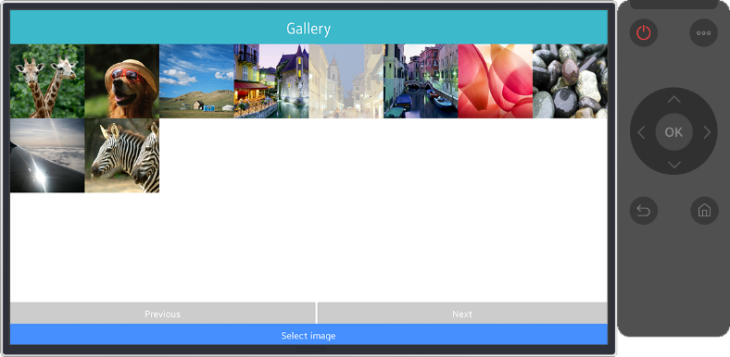
.NET Core Support on Tizen
Build Tizen apps for mobile devices and TVs with .NET Core and Xamarin.Forms
Preview #1
Preview #2
Preview #3
Preview #4
Official Release
Mobile
Nov 2016
Mobile/TV
Jan 2017
Mobile/TV
Mar 2017
Mobile/TV
June 2017
Mobile/TV
End of 2017
Visual Studio Tools for Tizen
Supports everything you need to
develop Tizen apps with .NET
https://developer.tizen.org/development/tizen-.net-preview/

Slide 24
Guidance - .NET Architecture
Available now at: https://dot.net/architecture
eBooks & samples: Web, Containers, mobile
Patterns: Health checks, queueing
More books and patterns coming…

Slide 25


Slide 26
Announcing .NET Core 2.1 https://aka.ms/DotNetCore21

Slide 27
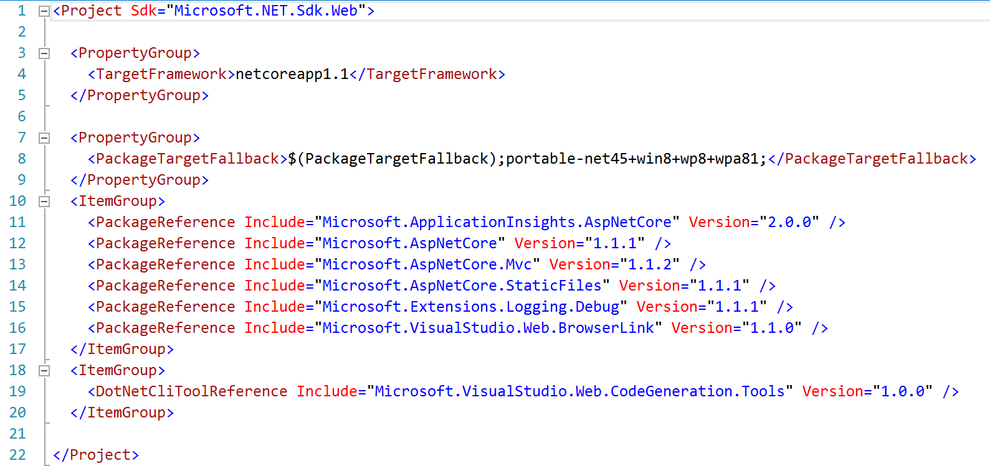
.NET Core 1.0 references

Slide 28
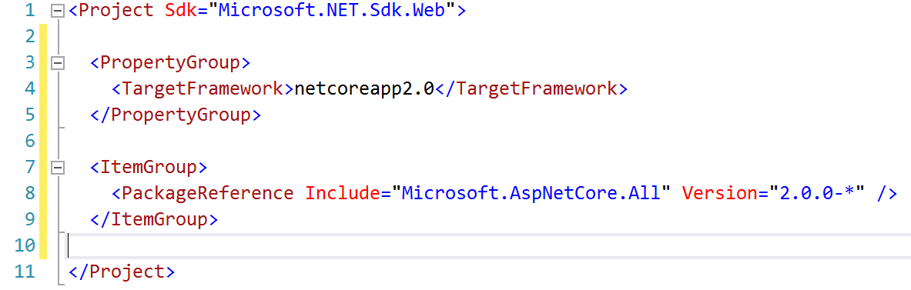
.NET Core 2.X references

Slide 29
.NET Core 2.1 Themes
Faster Build & Runtime Performance
Close gaps in ASP.NET Core and EF Core
Improve compatibility with .NET Framework
GDPR and Security
Microservices and Azure
Faster Internal Engineering System
Download .NET Core 2.1
https://aka.ms/DotNetCore21

Slide 30
.NET Core 2.1 Tooling Performance
TIME IN SECONDS

Slide 31
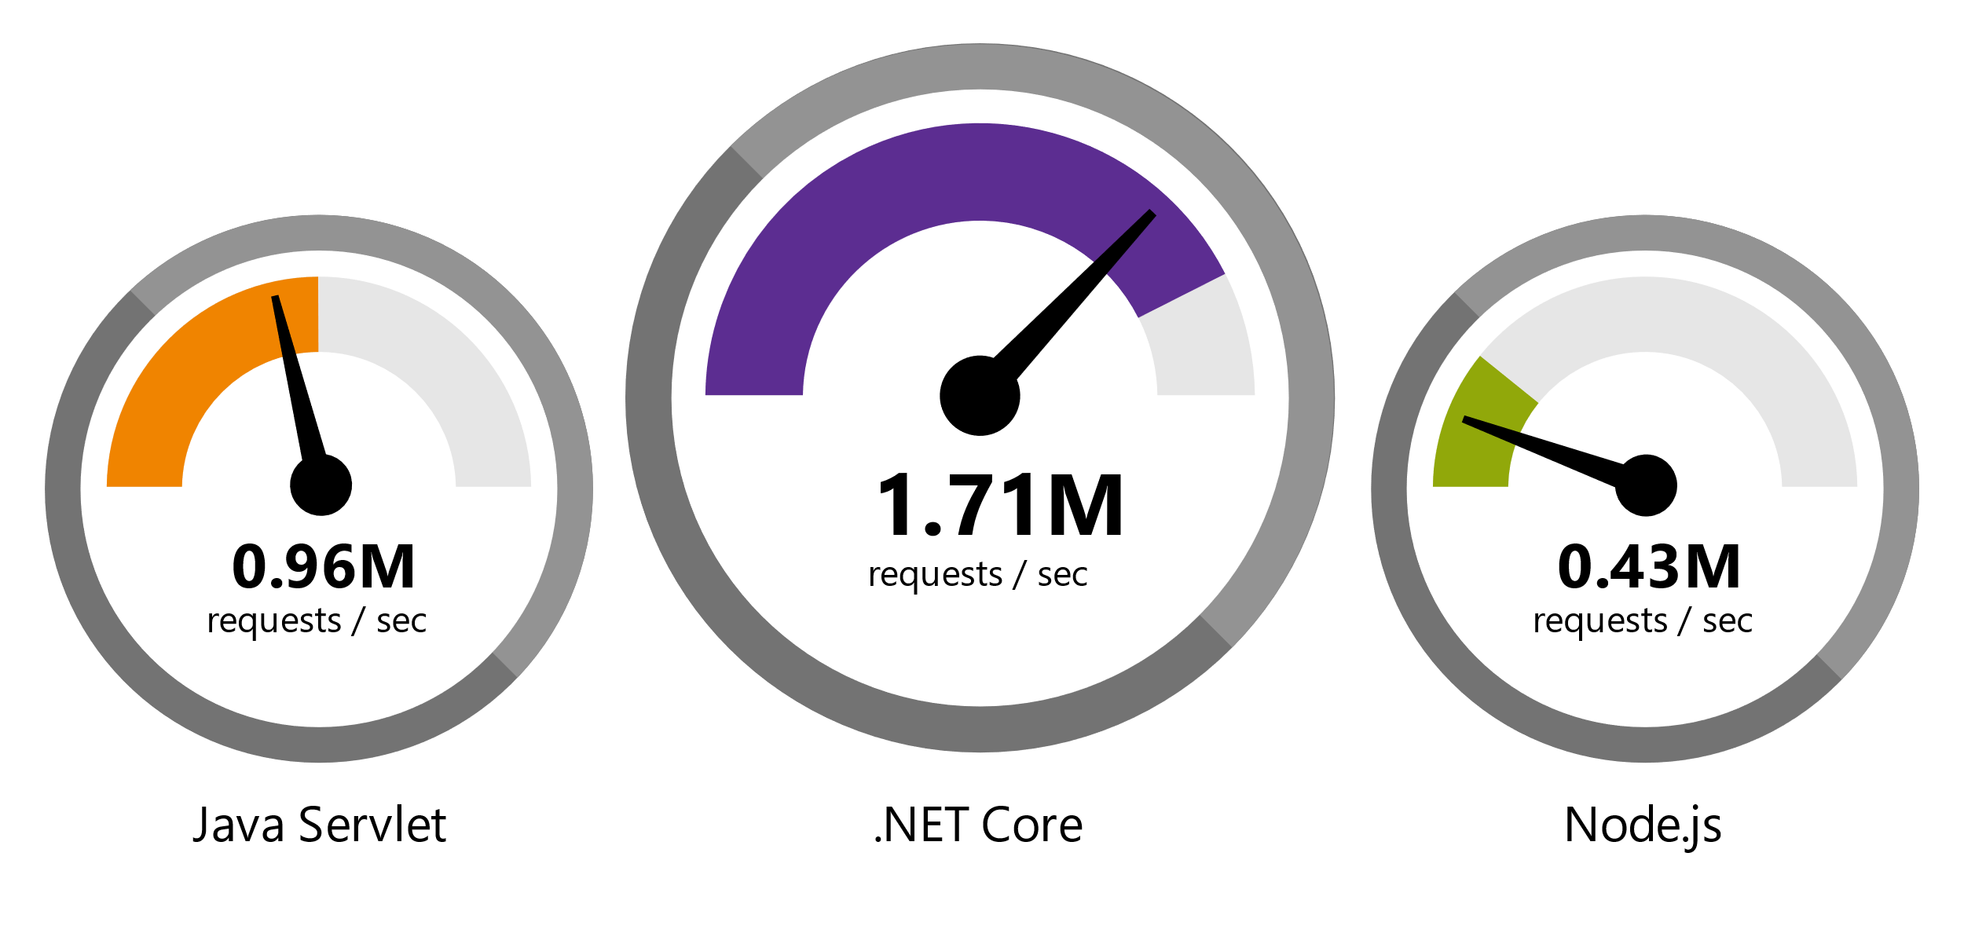
.NET Core 2 is Fast
Data sourced from official tests available at TechEmpower Round 14.
“Using the same-size server, we were able to go from 1,000 requests per second per node with Node.js to 20,000 requests per second with .NET Core.“ — Raygun
https://www.microsoft.com/net/customers

Slide 32
.NET Core 2.1 is Faster!
REQUESTS / SECOND
+12%
+11%
+123%

Slide 33
.NET Core 2.1 Major Features
.NET Core
Lazy Loading
Value conversions
Query types
Data seeding
ASP.NET Core
Global Tools
Span<T>
Sockets
HttpClient Performance
Windows Compatibility Pack
EF Core
HTTPS
Razor UI as a library
HttpClientFactory
ASP.NET Core SignalR

Slide 34
Tooling - Visual Studio 2017
Improved performance, new install experience
Faster navigation
Code style configuration and enforcement
Live Unit Testing
IntelliSense improvements
New exception helper
More refactorings and quick fixes
C# 7.0

Slide 35
Visual Studio 2017 Update 3
Additional polish to navigation and IntelliSense
.NET Core support for Live Unit Testing
Code style enforcement on builds
More live diagnostics on API design, security, etc.
Even more refactorings and quick fixes
C# 7.1

Slide 36
Tooling - Visual Studio for Mac
Provide the SAME experience across Windows and Mac
Sharing components with Visual Studio
.NET Core Project Templates
HTML, CSS, JSON editors
Backend debugger
Azure Publish infrastructure
Future
Javascript, Razor editors

Slide 37
.NET Core and Visual Studio for Mac
Full .NET Core Tooling including round tripping between Windows and Mac
Docker Containers with debugging
Publish to App Service
Publish to App Service Containers
Azure Functions

Slide 38
Demo: Visual Studio for Mac

Slide 39
Resources
.NET Core SDK
https://www.microsoft.com/net/core/
VS 2017 Update 3
https://www.visualstudio.com/vs/
.NET Architecture
https://www.microsoft.com/net/architecture
Editor Productivity & Refactoring Cheat Sheet
https://www.visualstudio.com/vs/net-productivity/

Slide 40
¿Preguntas?

Slide 41
¡ Gracias!
Mariano Sánchez
sanchezmariano@outlook.com @marianosz
http://weblogs.asp.net/marianos

